Slide 1
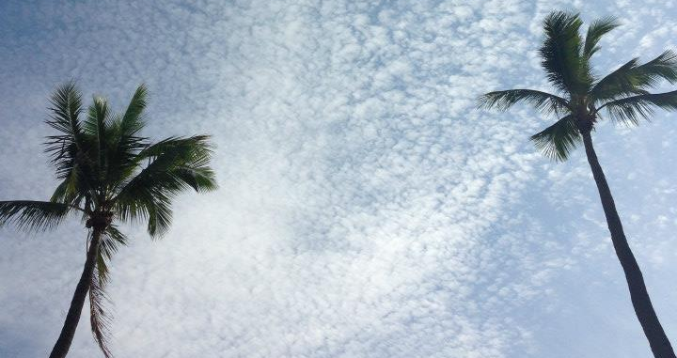
ATMO 102 Pacific Climates and Cultures
Lecture 5: Water, Rising Air,
Stability and Clouds

Slide 2

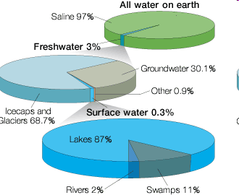

Water, water, everywhere, but not a drop to drink….
  Oceans account for most of water (>97%)
    Not readily useable by humans or plants
  Ice sheets in Antarctica and Greenland (~3%)
  Atmosphere has only a little (0.001%)

Slide 3
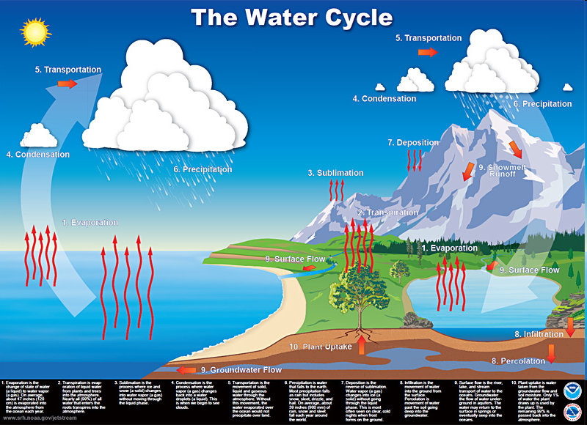
“The Hydrologic Cycle”
Condensation
Precipitation
Run Off
Transpiration
Evaporation
Infiltration

Slide 4
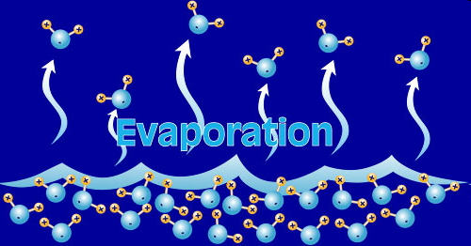
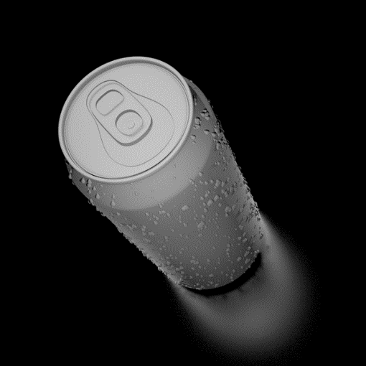
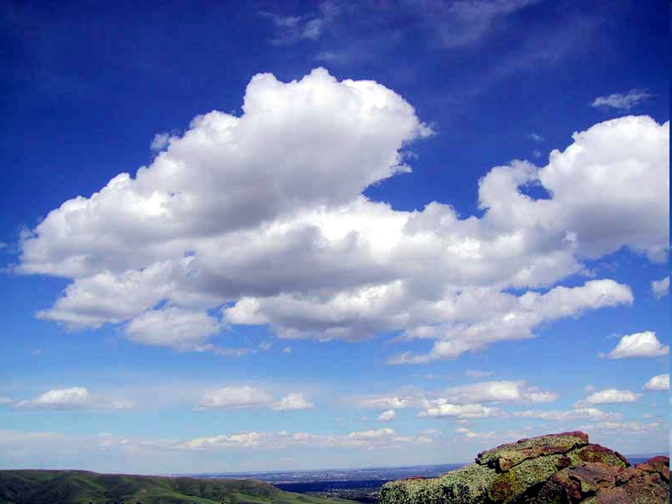
Processes Involving Water in the Atmosphere
Evaporation – Requires Energy
  The process by which a liquid is transformed into a gas
  Powered by the Sun!
  Solar Radiation heat up the water molecules until they are “freed” from the liquid state
  Heat is absorbed during evaporation
Condensation – Releases Energy
  The change from a gas to a liquid
  Responsible for the formation of clouds
  Heat is released during condensation

Slide 5
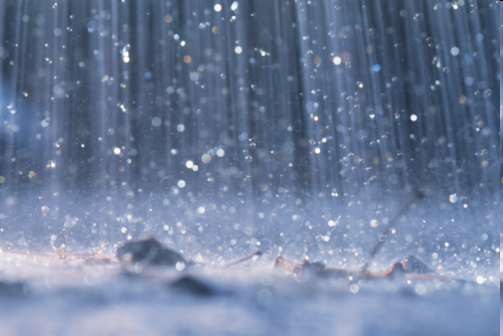
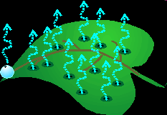
Processes Involving Water in the Atmosphere
Precipitation – Over Land & Oceans
  Falling liquid or solid in the atmosphere.
  Returned the water to the ocean or soaks into the ground
  Balances Evaporation
    Average annual precipitation equals evaporation.
Transpiration
  The release of water vapor to the atmosphere by plants
  Plants uptake water through their roots that fell as precipitation
  Not as important as evaporation

Slide 6
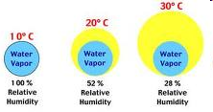
Relative Humidity
The ratio of the air’s actual water vapor content compared with the amount of water vapor required for saturation at that temperature and pressure
Water vapor content
Relative Humidity =
X 100 percent
Water vapor capacity

Slide 7
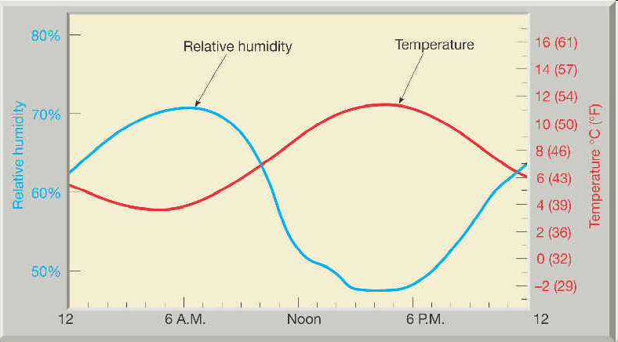
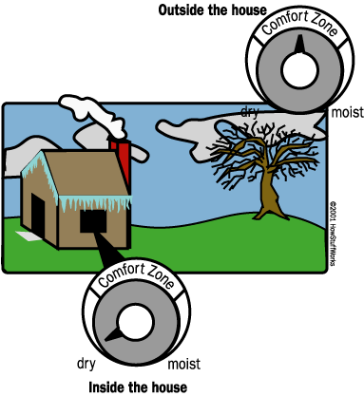
Natural Changes in Humidity
Daily changes in temperatures (daylight verses nighttime temperatures)
Temperature changes that result as air moves horizontally from one location to another
Temperature changes caused as air moves vertically in the atmosphere

Slide 8
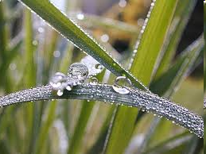
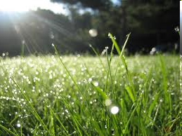
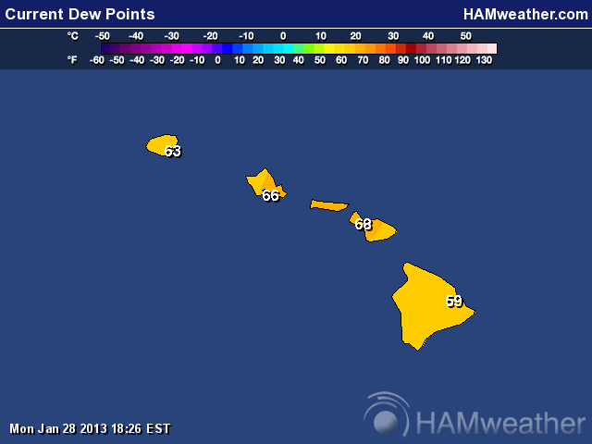
Dew Point Temperature
The temperature at which air needs to be cooled to reach saturation
It is a measure of the actual moisture content of a parcel of air.
The term dew point stems from the fact that during the night objects at the surface often cool below the dew-point are a coated with dew.
When the dew point exceeds ~65F it is considered humid by most people
A dew point above 75F is considered unbearable.
59 F – 68 F

Slide 9
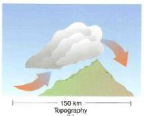
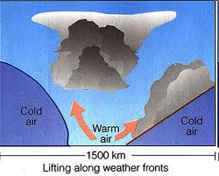
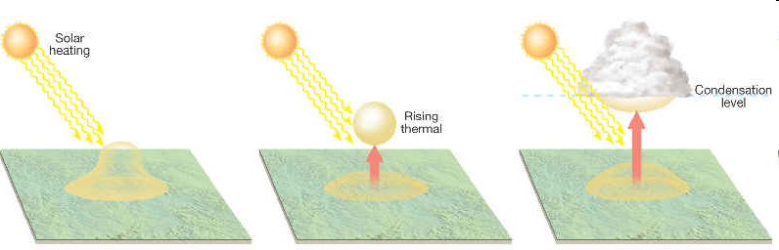
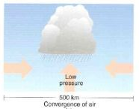
Processes that Lift Air
Orographic Lifting
Frontal Wedging
Convergence
Localized Convective Lifting (differential heating)

Slide 10
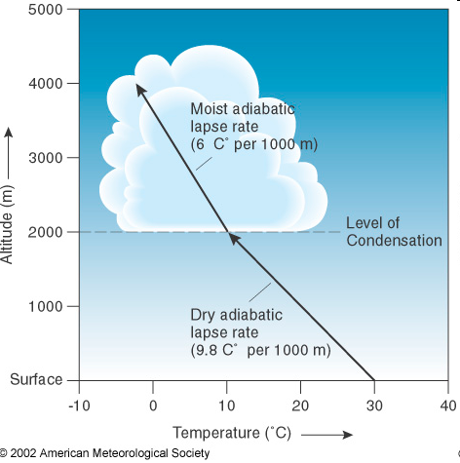
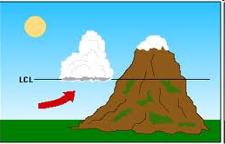
Lifted Condensation Level (LCL)
The height at which rising air that is cooling at the dry adiabatic rate becomes saturated and condensation begins.
Why most clouds have FLAT bottoms!!!

Slide 11
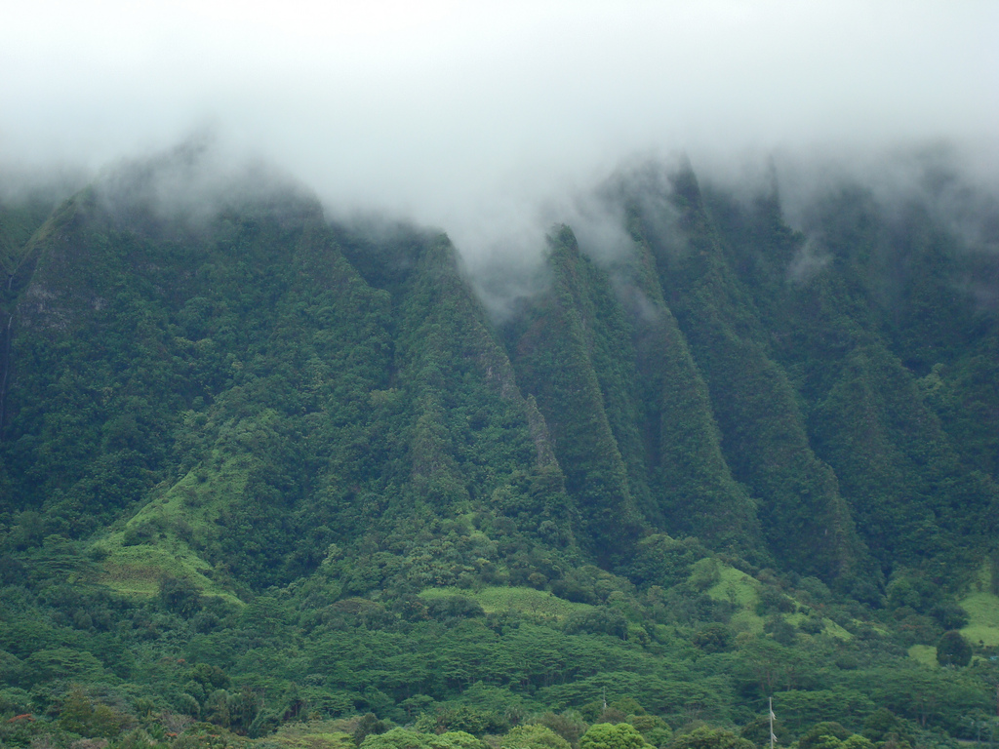
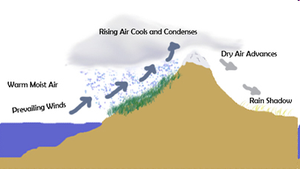
Orographic Lifting
Air is forced to rise over a mountainous or topographic barrier
Rain shadow desert

Slide 12
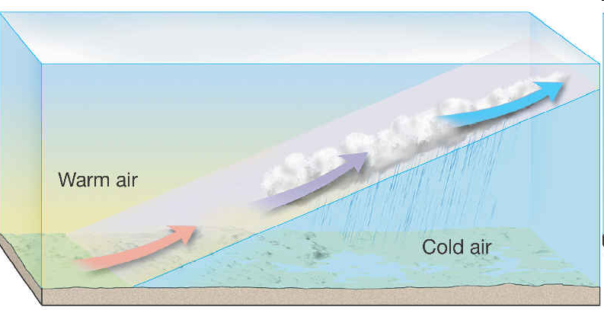
Frontal Wedging
Warmer, less dense air, is forced over cooler, denser air
Front – when warm and cold air collide

Slide 13
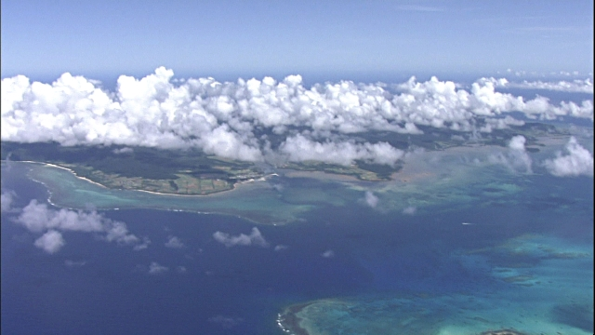
Localized Convective Lifting
Unequal heating of Earth’s surface causes pockets of air to be warmed more than the surrounding air.
Buoyant parcels (thermals) of hot air rise.
After reaching the LCL they form clouds.

Slide 14
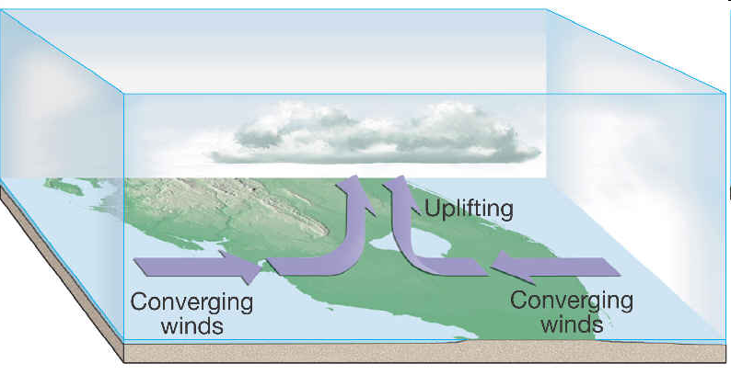
Convergence
When air flows in from more than one direction (not a front) can collides
  It cannot go down.
  It goes up.
Often happens over islands and other regions where two bodies of water are located closely together

Slide 15
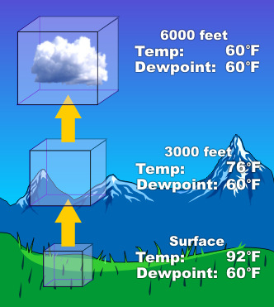
Air Parcels… What are they?
A Parcel is an imaginary volume of air
  Typically a few hundred cubic meters in volume
  Acts independently of the surrounding air
  It is assumed that no heat is transferred into, or out of it
  HIGHLY IDEALIZED
We use them to talk about the likelihood that air will rise up or sink down.
  We need to know this if we want to predict if clouds will form.
When air is allowed to expand, it COOLS.
When air is compressed, it WARMS.

Slide 16

Stability and Clouds

Slide 17

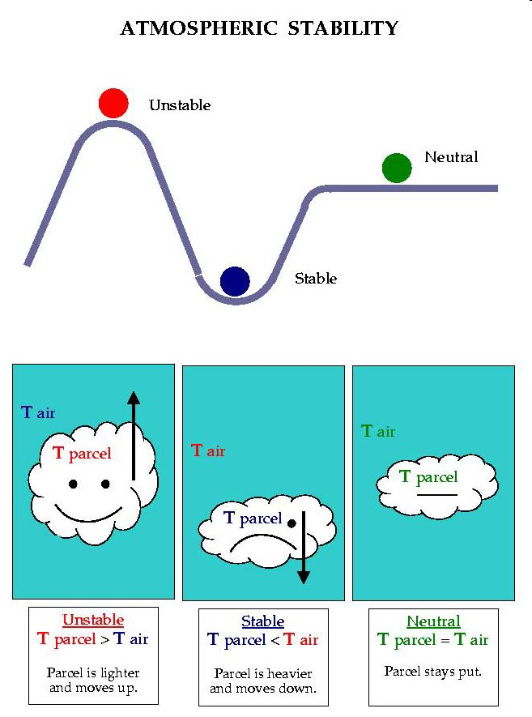
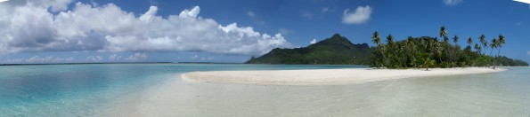
Atmospheric Stability
When air rises it cools and eventually produces clouds
By comparing a parcel of air to its surrounding you can tell if will rise or sink

Slide 18
Atmospheric Stability
Stable Air
  If a parcel were cooler than the surrounding environment, it would be more dense
  If allowed to do so it would sink back to it’s original position
  Air of this type resists vertical motion

Slide 19
Atmospheric Stability
Unstable Air
  If a parcel were warmer than the surrounding environment, it would be less dense
  If allowed to do so it would rise until it reached an altitude where it’s temperature equaled that of its surroundings.

Slide 20
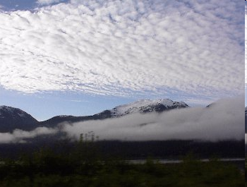
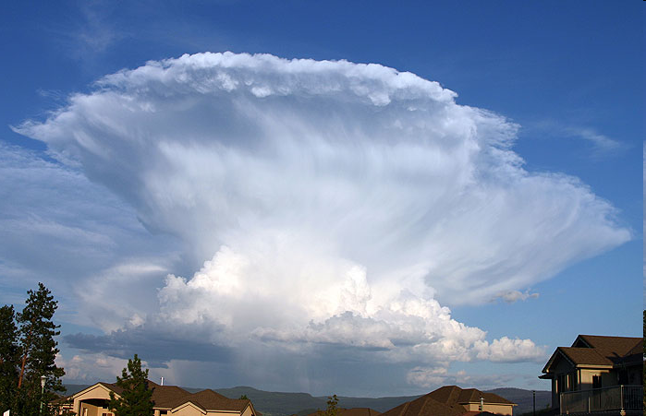
Stability and Daily Weather
In general, when stable air is forced aloft, the associated clouds have little vertical thickness, and precipitation, if any, is light.
In contrast, clouds associated with unstable air are towering and frequently accompanied by heavy rain.
  e.g. the thunderstorms we had last fall were caused by unstable air related to passing hurricanes

Slide 21
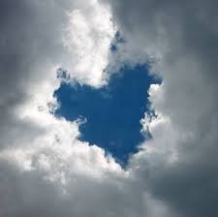
Clouds!
A cloud can be defined as any visible aggregate of tiny droplets of water or tiny ice crystals, or a mixture of both.
  They are beautiful and are the main features in many folktales, mele, oli and other stories and art.
  They help meteorologists, and the ancient Polyneisans, figure out what’s going on in the atmosphere and what will happen in the future.
  The basic Hawaiian word for cloud is ao, but there are many cloud descriptions.
  Clouds are also named after colors, with 'ele'ele referring to a black cloud and ke'oke'o to a white cloud. A sheltering cloud is called ho'omalumalu and a threatening cloud, ho'oweliweli.
Sky: The word for sky is lani.
Dr. Griswold LOVES Clouds!

Slide 22
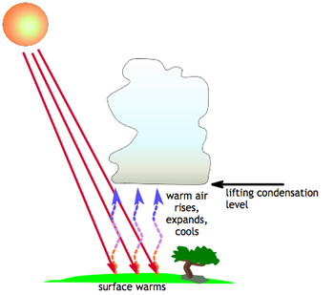
Recipe for a Cloud
Cloud Condensation Nuclei (CCN)
  Particles of sea salt, dust, other materials
  Serve as the surface for water vapor to condense upon
Rising Air
  By one of the methods described on Tuesday.
  Causes cooling
  Condensation occurs at the LCL
Water Vapor

Slide 23
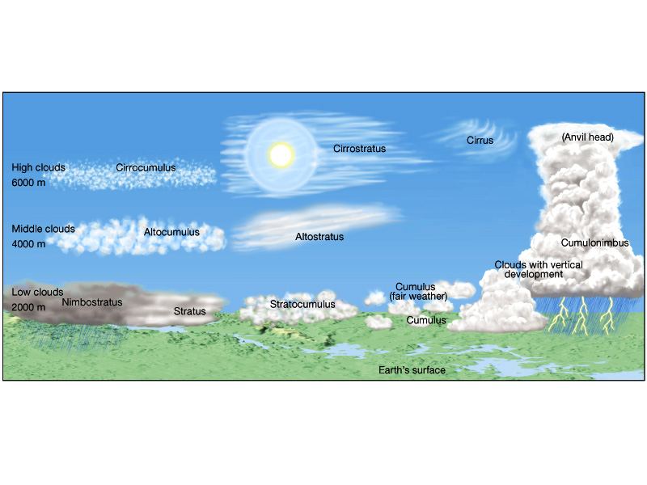
Cloud Classification

Slide 24
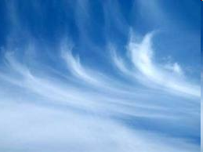
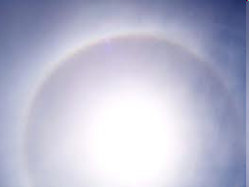
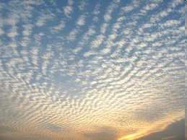
High Clouds
Cirrus
  Fibrous, “mare’s tails”
  pūrehurehu/ pūrerehu – in Maori
Cirrostratus
  White, produces halo
  Approach of warm front
Cirrocumulus
  White, small cells or ripple
  looks like “Fish Scales”
  māra kūmara a Ngātoro-i-rangi – in Maori
Above 6000 m (20,000 ft)
ICE ONLY
No Significant Precipitation

Slide 25
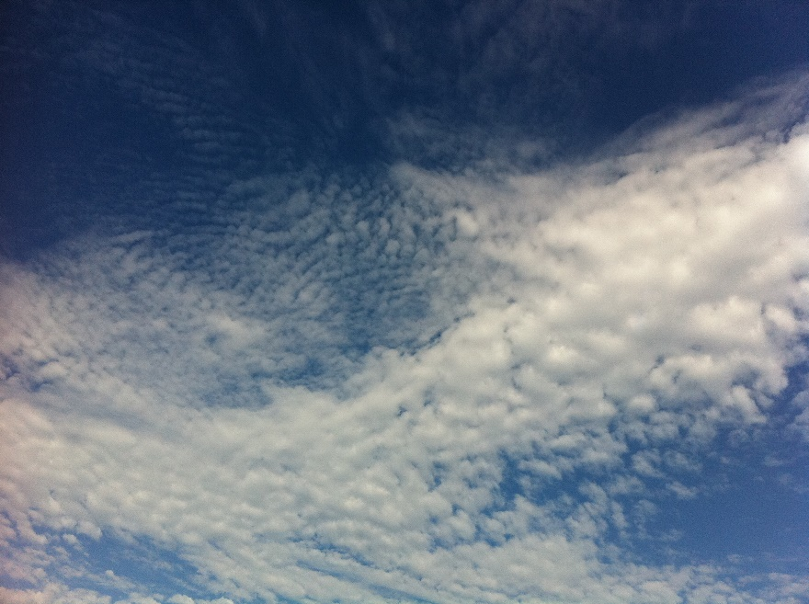
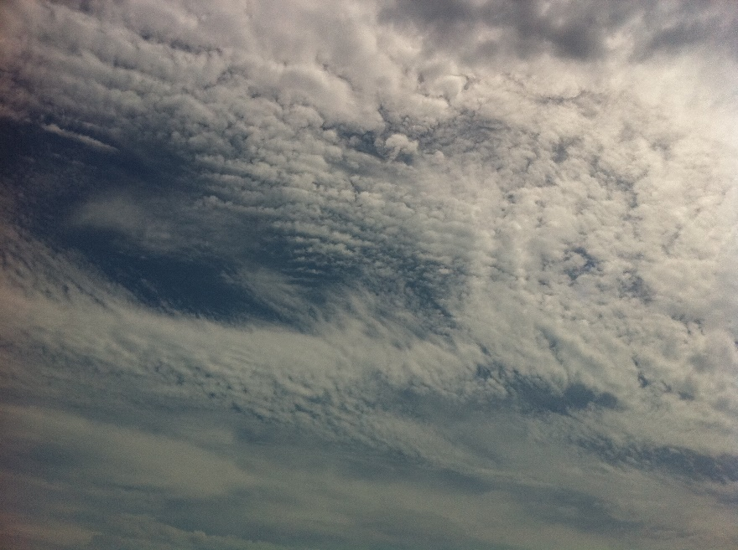
Middle Clouds
Altocumulus
  Large patches of rounded masses or rolls
  Usually water droplets
Altostratus
  Formless layer of grey cloud cover
  Sun is only visible as a bright spot.
  NO Halos
Between 2000-6000 m (6,500-20,000 ft)
Mostly Water
Infrequently Precipitates Snow or Drizzle

Slide 26
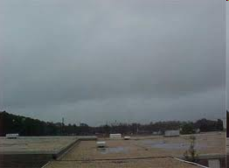
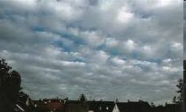
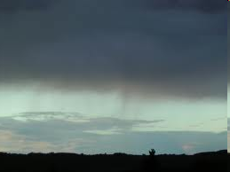
Low Clouds
  Stratus – ao loa – in Hawaiian
  Uniform layer covering most of sky
  Sometimes precipitation
  pūtahi – in Maori
Stratocumulus
  Scalloped bottom, covering most of sky
  Long parallel rolled or blobs
Nimbostratus
  Chief precipitation producers (light but for a long time)
  Associated with Stable conditions
  okewa – in Maori
Below 2,000 m (6,500 ft)
LIQUID ONLY

Slide 27
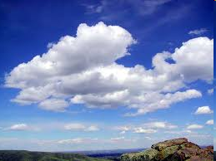
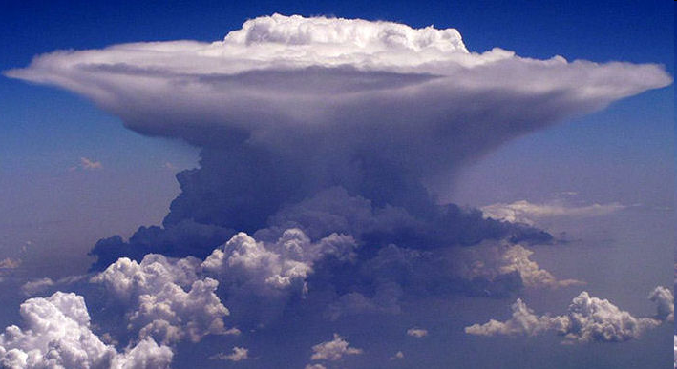
Clouds with Vertical Development
  Cumulus - aopua'a – in Hawaiian
  Individual masses that develop into vertical domes or towers
  Tops often resemble cauliflower
  Form on clear days
Cumulonimbus
  When Cumulus grow out of control
  Dark, dense, billowing clouds
  VERY TALL 12-20 km (7-12 miles)
  aopehupehu – Clouds that are swelling up
Bases are low (below 2,000 m) Tops up to 20 km!!
Water at the base, can have ice if they grow tall enough
Related to unstable air
pua'a – means PIG in Hawaiian
'opua – A bank of Trade Wind Cumulus

Slide 28
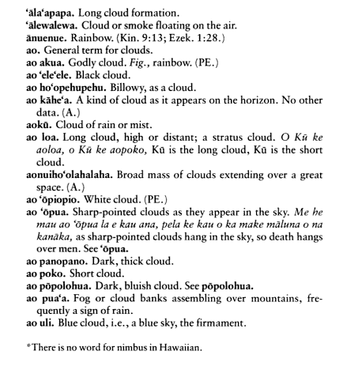
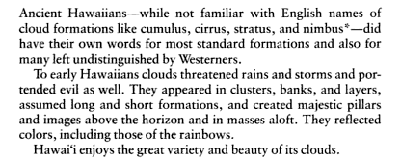
Hawaiian Words Related to Clouds
Treasury of Hawaiian Words in One Hundred and One Categories
By Harold Winfield Kent

Slide 29
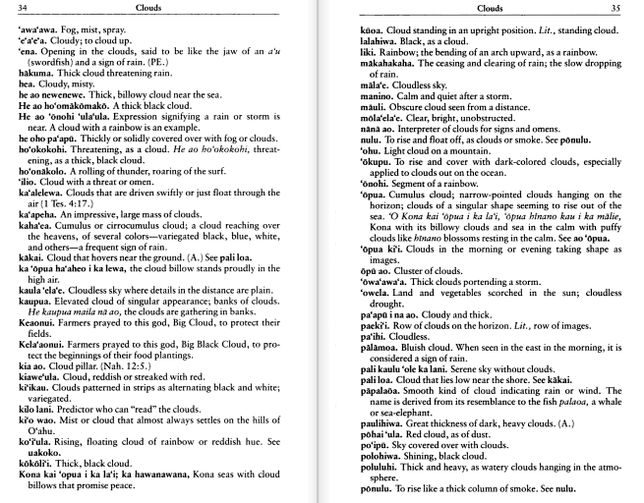
Hawaiian Words Related to Clouds
Treasury of Hawaiian Words in One Hundred and One Categories
By Harold Winfield Kent

Slide 30
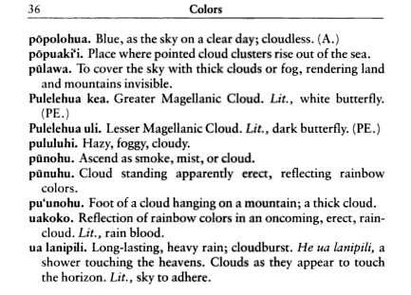
Hawaiian Words Related to Clouds
Treasury of Hawaiian Words in One Hundred and One Categories
By Harold Winfield Kent

Slide 31
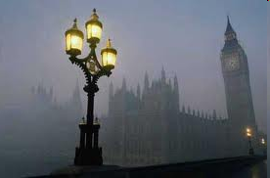
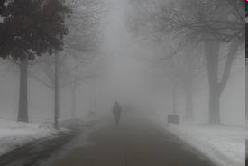
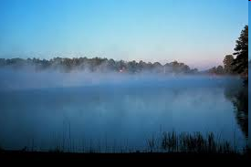

Types of Fog
FOG = a cloud with its base at or very near the ground.
Fogs formed by Cooling
  Radiation Fog
  Advection Fog
  Upslope Fog
Fogs formed by Evaporation
  Steam Fog
  Frontal Fog

Slide 32
Discussion if there’s time
How does the naming of clouds differ when we compare our modern method to the names of the Hawaiians?
The Hawaiian words for clouds are extremely descriptive of specific situations.

